Slide 1
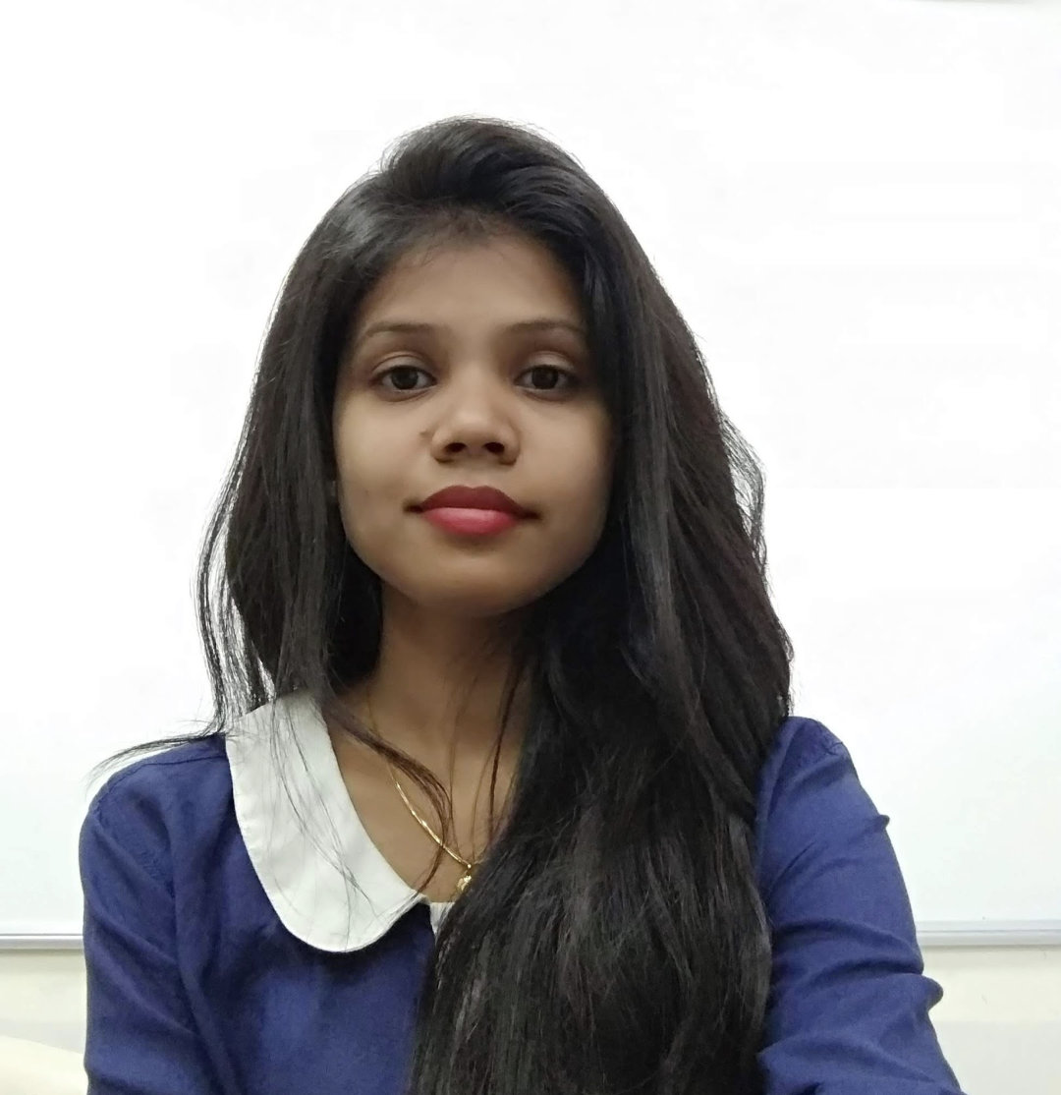
Nikita Deepak Poyrekar
Professional Experience
Nikita has 2+ years of professional experience in software development and 1 year of experience into a management role. She is also a Freelance educator, providing instructions to the students from the engineering and BSc I.T. background. Her key strength in software development includes but not limited to – developing user facing features by translating the UI designs into actual code that produce visual responsive elements of web applications using the state-of-the-art JS frameworks like Angular, React and Next.js. She has carefully led the entire PED (Product, Engineering and design) team for projects that covers Healthcare, Property and retail management sector.
She is well acquainted of software development practices
She has good hands-on experience in working through the environments adopting both – Waterfall and Agile project life cycles
She is also a good presenter and has volunteered many product demonstrations and presentations.
Tools & Technology:
Programming languages: JavaScript, HTML5, CSS3, Less, Python, etc.
Frameworks; Bootstrap, Angular and Next.js
Libraries: React, Angular Material and Ant design
Version control: Git, GitHub and Bitbucket
Database: SQL (PostgreSQL)
UI design tools: Figma, InVision and Zeplin
API testing/integration tools: POSTMAN and Swagger
Project management tools; Airtable and Atlassian tools like JIRA and Confluence
DESIGNATION: Consultant
Phone: +91 8976548557
EMAIL: npoyrekar@deloitte.com / nikita.poyarekar5@gmail.com
Qualifications
B. E : Mumbai University
MTech: KJ Somaiya college of engineering
Primary skills
Key Engagements
Frontend development – React and Next.js
Familiarity with Angular 7+ and Python
Confident communicator and Presenter
Collaborated and worked with client and their teams in USA through previous employment for creating a tool that simplified the tenant and landlord experience in the property and retail management sector. Worked with the PED team to gather requirements, resolutions to the existing problems, developing technical specification also executed the same. Good experience in constantly reevaluating customer priorities while delivering timely outcomes.
Testing experience: Involved in defining and executing test cases at basic level using JEST and react testing library.

